Slide 1
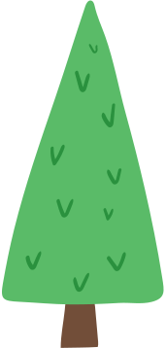
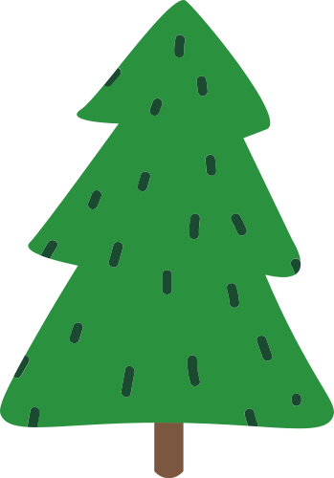
MEET
THE
TEACHER
My Family
I have one brother and two sisters
Mrs Abbey
Hobbies
I play tennis every weekend, and I also love to read.
Pets
I have a pet dog called Toby
Favourite subject:
Biology

