Slide 1
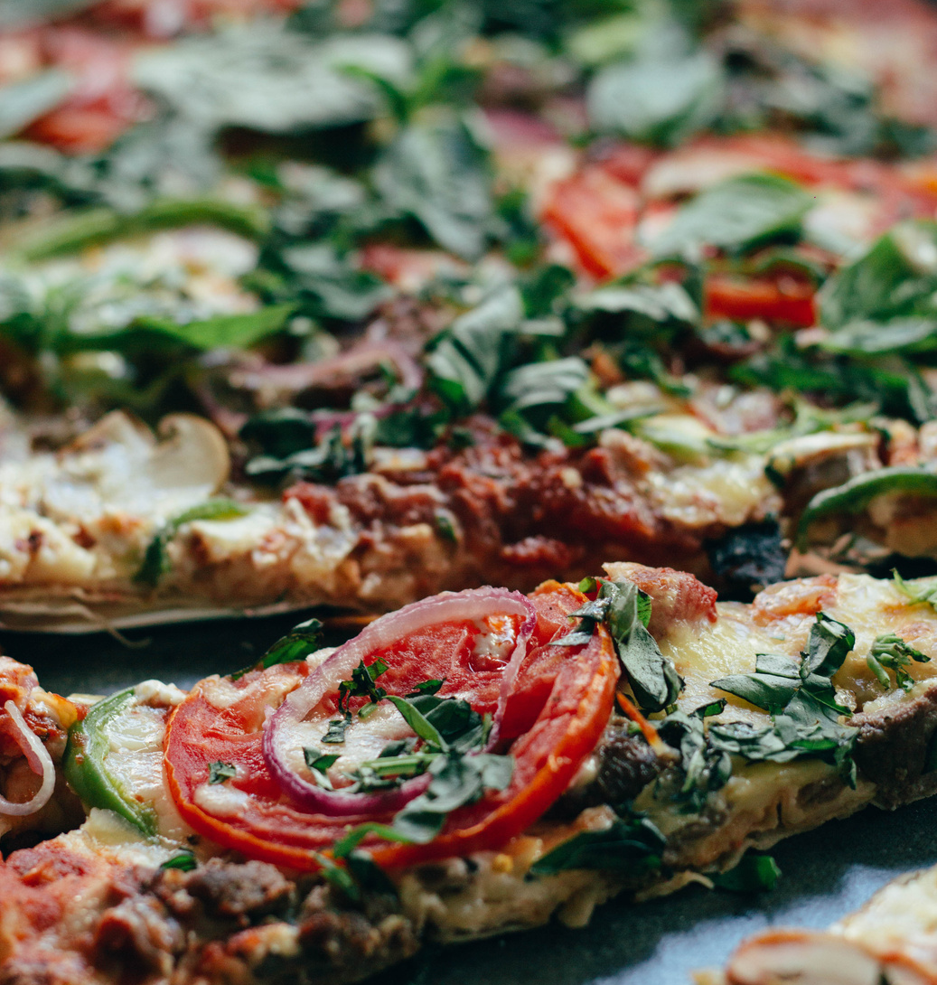
POINT PLACE PIZZERIA
DINE WITH US
123 Anywhere St., Any City, ST 12345
+123-456-7890
hello@reallygreatsite.com
www.reallygreatsite.com
Traditional Pizzas
Serving great pizzas and keeping the oven hot since 1991

Slide 2
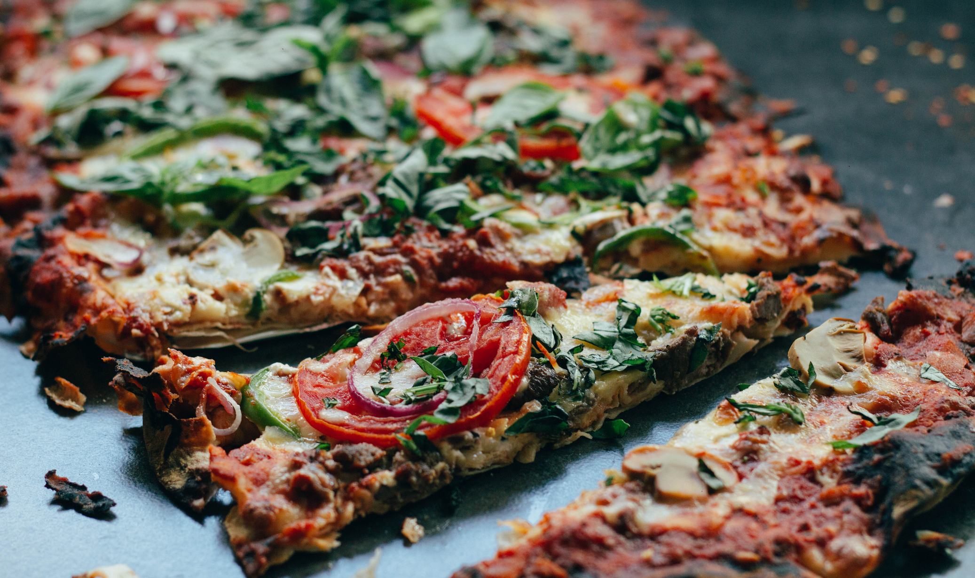
CUSTOMIZE
THE DOUGH
Make sure to feature your bestsellers or signature products or pieces. Keep it simple and to the point by listing the name, price and brief description.
THE CHEESE
Make sure to feature your bestsellers or signature products or pieces. Keep it simple and to the point by listing the name, price and brief description.
THE PIZZA
THE TOPPINGS
Pizza is definitely better when eaten among friends and family.
Make sure to feature your bestsellers or signature products or pieces. Keep it simple and to the point by listing the name, price and brief description.
Trifold brochures have long been a type of material used to advertise brands, products, and services. The best way to maximize its use is to introduce what the brand has to offer with a brief or about section like this. Make sure to keep your introduction short but interesting enough to readers.

